Slide 1

The Glassy Van and The Car
Buy them before they run out!

Slide 2
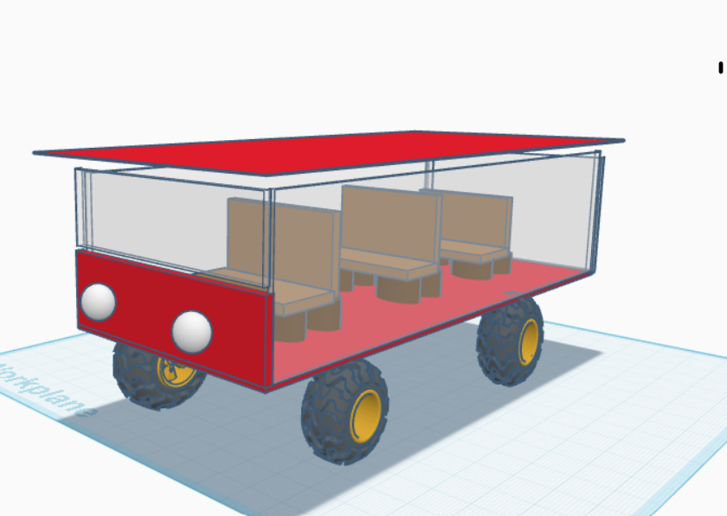
This is The Glassy Van, the first of the collectables, and it is very rare and awesome.

Slide 3
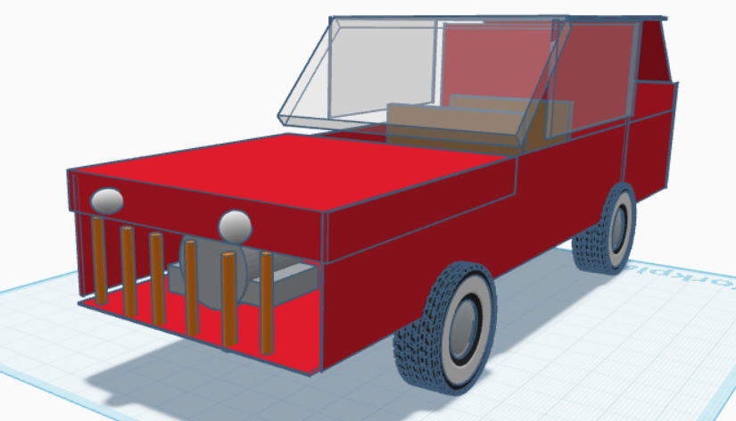
This is The Car, another collectable item that is more common than The Glassy Van but still awesome.

Slide 4




If you read this power point, then you get 20% off!

